Slide 1
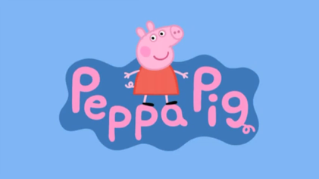

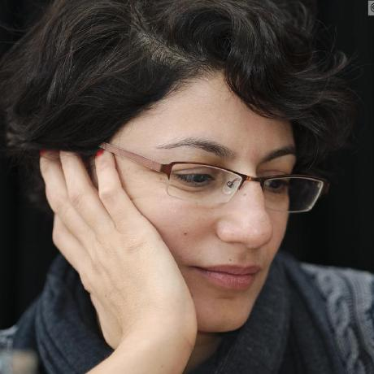

Learning English with
Mitja Nikolaus Afra Alishahi Grzegorz Chrupała

Slide 2
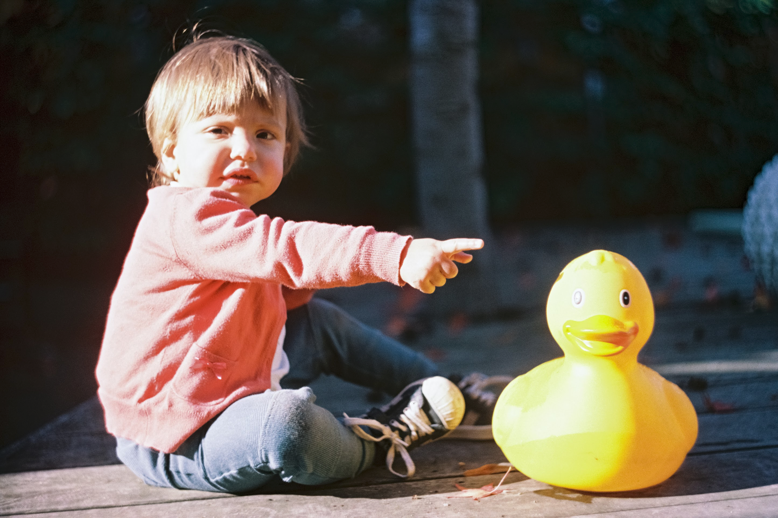
How do children learn a language?
Language-internal statistics
Correlations with objects and actions present in scenes co-occurring with speech.
Clues such as gaze and pointing
Other incompletely understood mechanisms

Slide 3
Can we model this computationally?
Modeling this is a difficult open problem.
Some progress on learning from correlations with co-occurring scenes.

Slide 4

Video datasets with narrative descriptions

Slide 5
Real-world data
A: They are fighting over bread.
C: What?
A: They are fighting over bread.
C: Yeah.

Slide 6
Ecological validity
Image/video captions
Strong correlations between visual scene and the meaning of the utterances.
Few/weak correlations between scene and non-linguistic features of the audio.
Real world data
Weaker correlations between visual scene and meaning of the utterances.
Correlations between scene and non-linguistic features of the audio are common
speaker voice
environmental sounds

Slide 7
Peppa Pig Cartoons

Slide 8
Peppa Pig Cartoons
Aimed at young children
Simple cartoon graphics
Simple but realistic spoken language
Correlations between speech and visuals tend to be there but less consistent than in captions
Frequent confounds with non-semantic features.

Slide 9
Peppa Pig: dialogs vs narrations
Dialogs
conversations among cartoon characters
Narrations
comments by narrator
often descriptive

Slide 10
Narrations for evaluation
Train on dialogs
Evaluate on narrations
Descriptive
Voice held constant
If model trained on dialogs generalizes to narrations
Evidence that it’s using semantic features of speech
Does not rely only on confounds

Slide 11
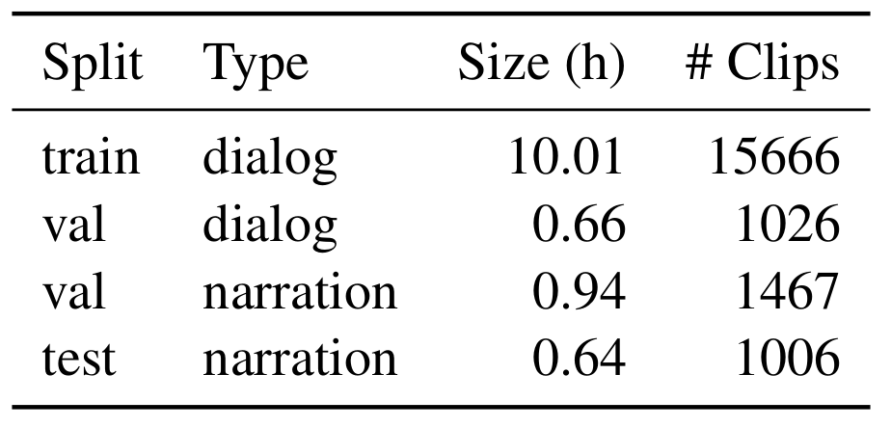
Data
Split into dialog and narration carried out by: Papasarantopoulos, N., & Cohen, S. B. (2021). Narration Generation for Cartoon Videos. arXiv preprint arXiv:2101.06803.

Slide 12
Segmentation
Fixed
Video/Audio clips of 2.3 seconds
Generalization to other sizes?
Jitter
Video/Audio clips independently randomly resized around mean=2.3 seconds

Slide 13
Pretraining
Audio
Self-supervised
Wav2Vec 2.0
960 hours of read English speech
Video
Supervised
ResNet (2+1)D
600K 10s clips (Kinetics)

Slide 14

Architecture
Contrastive loss

Slide 15
Evaluation: clip retrieval
Embed audio and video clips
Rank candidate video clips
Recall @ 10
# times correct clip among top 10

Slide 16
Evaluation: binary choice with triplets
Extract video/audio clips aligned with subtitle lines
Sample triplets of same length
Compute success rate: anchor closer to positive than negative
Strawberry!

Slide 17
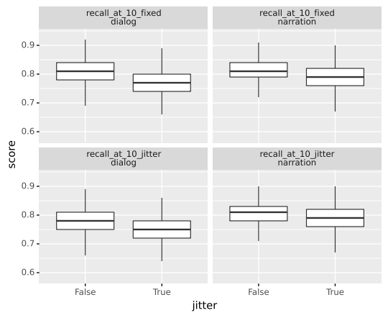
Fixed vs variable size segments

Slide 18
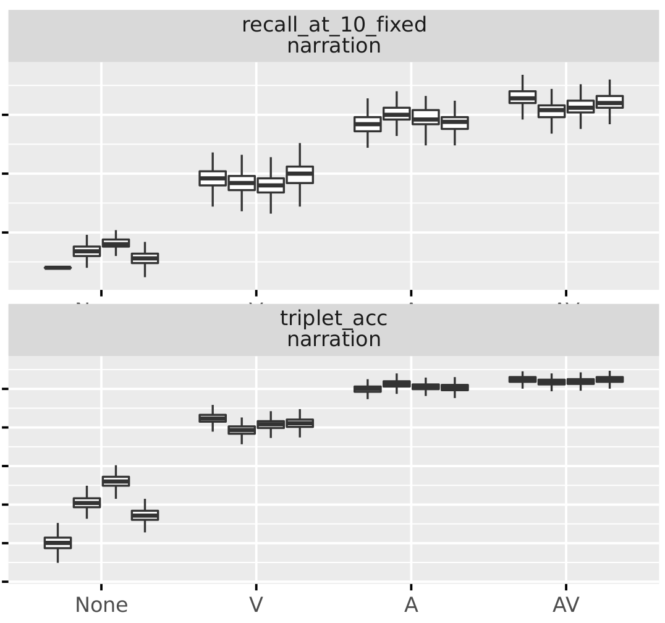
Effect of pretraining
Notes:
AV - 206974
A - 206975
V - 206976
None - 206977

Slide 19
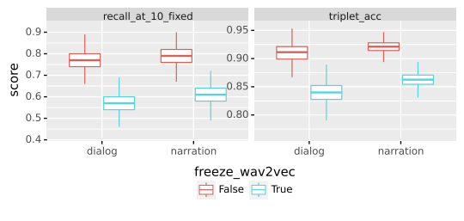
Effect of fine-tuning

Slide 20
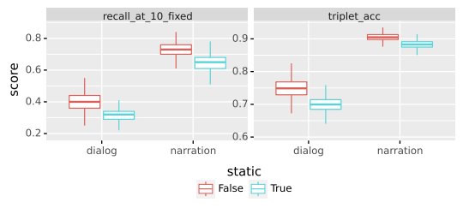
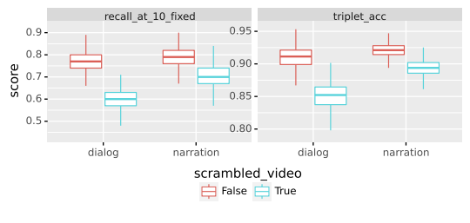
Effect of temporal information

Slide 21
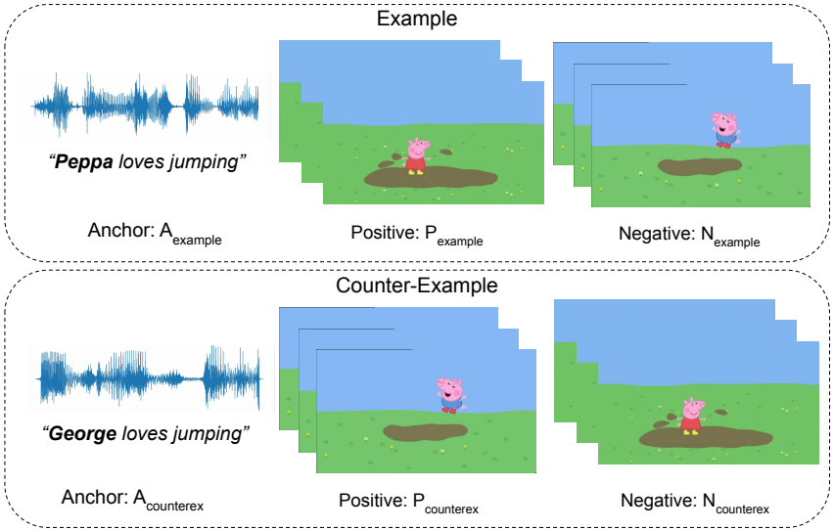
Evaluation: minimal pairs
Triplets matched to differ by a single word (via aligned transcriptions). Allows to partition results by word, grammatical category.

Slide 22
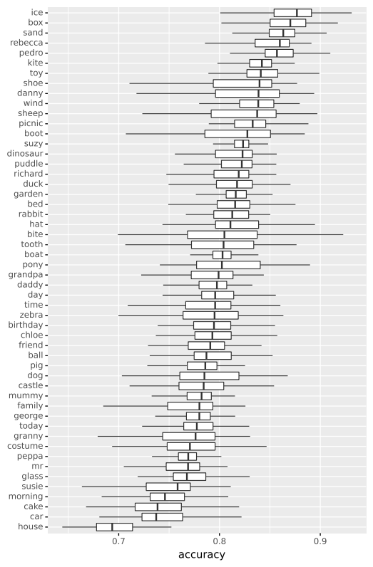
Minimal pairs
Patterns specific to Peppa cartoons
Character names (Rebecca) easy
house hard because often features in displaced speech, or not wholly visible.

Slide 23
Conclusion
Learning possible despite weak supervision and confounding
Pretraining, temporal information important
Fine-grained analysis would benefit from a larger and less specific dataset

